Slide 1
An interactive platform to give health its rightful place
in the French presidential debate
PASCAL LELIÈvre, Assistant to the Director Communications and Information – AMICE/ICMIF, 20 June 2017

Slide 2
The background of "place de la sant֤É" Project
A problematic context
The 2017 presidential debate was likely to focus on topics very popular with the media such as immigration, unemployment or the fight against terrorism >>> In this context, how to give health its rightful place in public discussions?
Mutualité Française is going through a period of political transition. The release of a platform with proposals and demands would therefore be premature >>> What to say between now and our next Congress in June 2018?
Our Department of Communications is preparing the first formal brand platform of Mutualité Française for the autumn 2017 >>> Can we speak while renewing our lexicon and reinventing our modes of expression on our ideas, activities and values?

Slide 3
The background of "place de la sant֤É" project
Significant challenges
To be the voice of French people in terms of access to health care, the financing of social protection, elderly people’s loss of autonomy, prevention and health promotion...
To affirm Mutualité Française’s legitimacy as the leader in the field of complementary health insurance and as a key stakeholder with the future new government
To open up the mutualists movement to the world: to initiate new partnerships, to hear different voices, to explore new territories of innovation

Slide 4
Our solution: TO BUILD A web Platform: placedelasantE.FR
“Health Square” is both…
A forum where citizens can debate about health issues
A call to candidates for the Presidency: what priority do you give to health issues in your programs?

Slide 5
a comprehensive COMMUNICATIONS plan from dec. 2016 to june 2017
The main tools 1/2
A new website totally independent from the corporate website mutualite.fr
September 2016: call for tenders and selection of the web agency Toc Média
September – November 2017: design and development
A digital media plan to support the web traffic
Target audience: news websites, higher socio-professional classes, social networks
Purchase of keywords on Google

Slide 6
a comprehensive COMMUNICATIONS plan from dec. 2016 to june 2017
The main tools 2/2
Activity on social media corporate accounts

Slide 7
a comprehensive COMMUNICATIONS plan from dec. 2016 to june 2017
Key steps
1 December 2016: the website PlacedelaSanté.fr is launched
The candidates’ programs were analysed by Mutualité Française’s experts
Articles and opinion pieces were published by our partner think tanks
Questions were posted on the website and shared on social media
21 February 2017: the public hearings of the candidates
Five candidates were interviewed by the famous TV journalist Audrey Pulvar
The program was live broadcasted on two news channels, La Chaîne Parlementaire and Public Sénat, with 350,000 viewers
191 journalists and 134 official personalities attended the event
17 March 2017: an open letter is addressed to the candidates
Publication in the national and regional daily newspapers

Slide 8
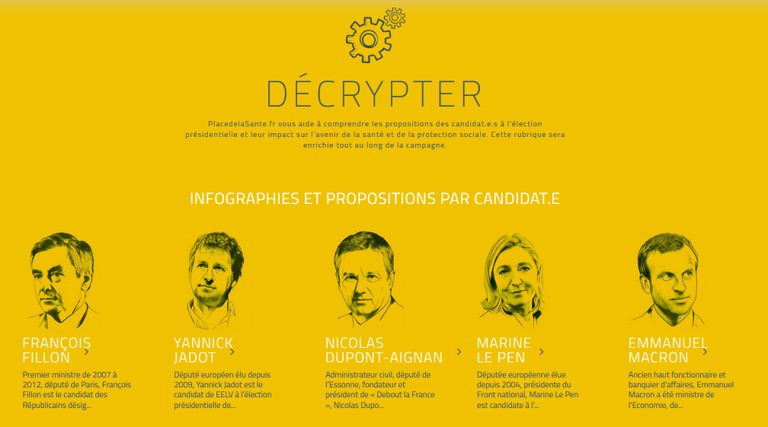
The platform is launched On 1 december in paris

Slide 9
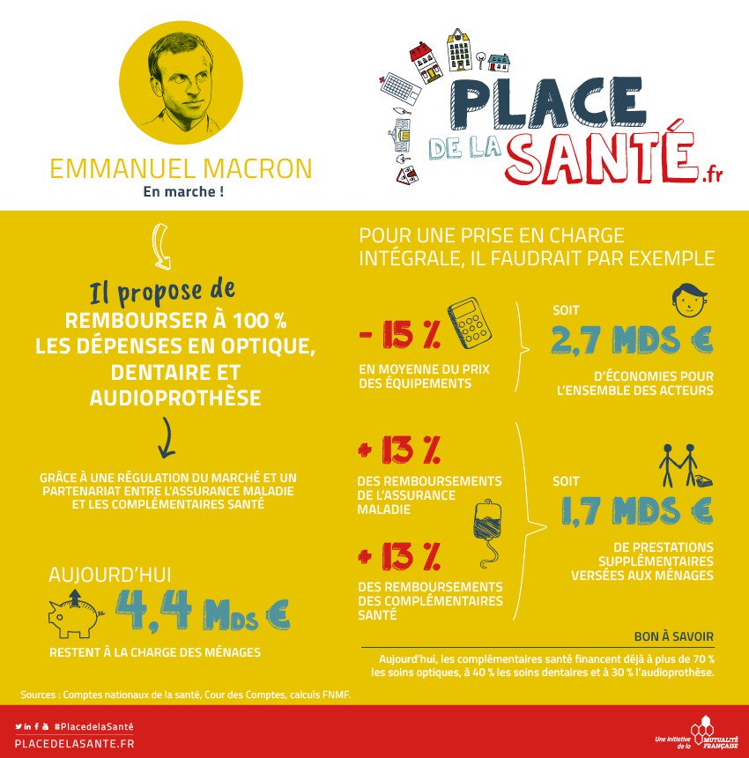
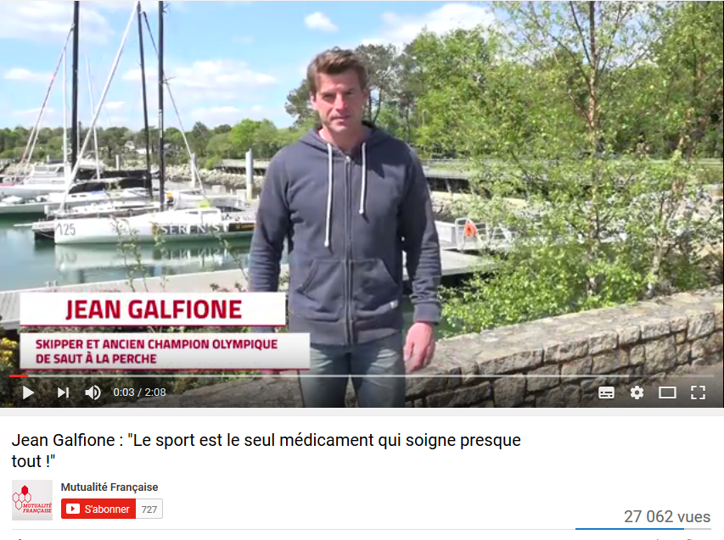
A wide range of contents

Slide 10
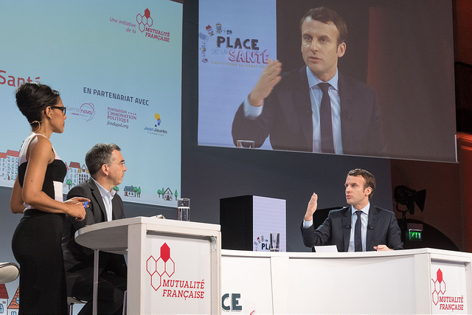
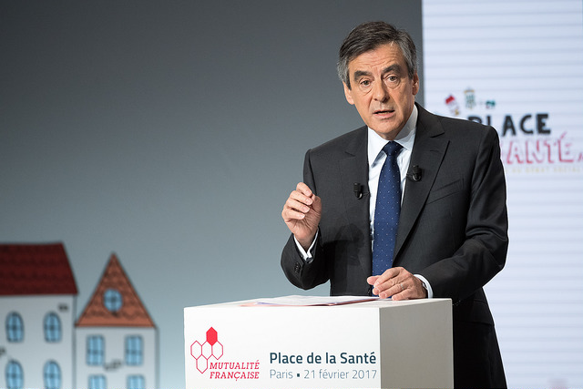
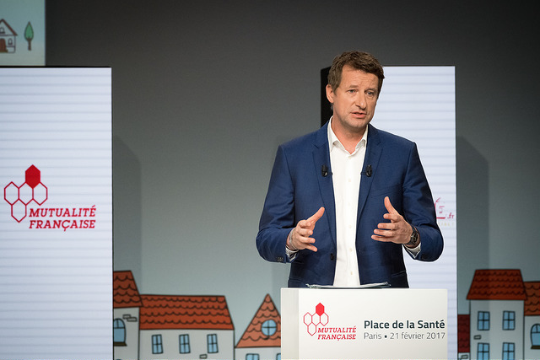
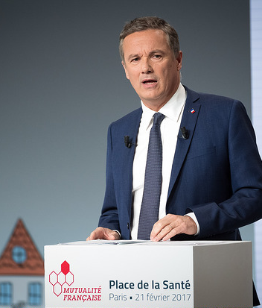
The success of the event ON 21 February
Five candidates for the Presidency at the Rendezvous Place de la Santé

Slide 11
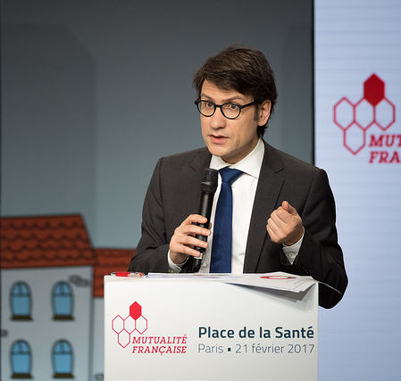
The success of the event ON 21 February
Five candidates for the Presidency at the Rendezvous Place de la Santé
An opinion poll on French people’s expectations for health and social protection conducted by Harris Interactive

Slide 12
an event watched on the web and social Media
350,000 people exposed to the event through our websites and social networks
100,200 people exposed to the video streaming
27,000 views
1,000 comments
674 interactions
352 shares
24,000 views through Periscope
227,000 persons exposed to ours tweets on 21st February
1,300 retweets
5,134 views
Up to 592 simultaneous connections
24 minutes: average length of viewing
PlacedelaSante.fr
20,500 visits
Fivefold of the daily traffic
Mutualite.fr
7,300 visits
Doubling of the average traffic

Slide 13
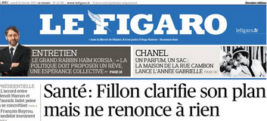
A successful press coverage of the event
350 items of media coverage: newspapers and web (170), TV (76), and radios (99)
Live transmission on
LCP et Public Sénat
new channels
and live shots
on BFMTV and
FranceTV Info
Le Figaro on 21 February
Live interviews with Mutualité Française President, Thierry
Beaudet
Front page headline, 2 first pages dedicated to the place of health issues in the campaign, interview with President Beaudet, poll results, …
LCP and Public Sénat doubled their audience
with 350,000 viewers
France Inter, RTL, RMC i-télé, LCI, BFM, Public Sénat, France 5

Slide 14
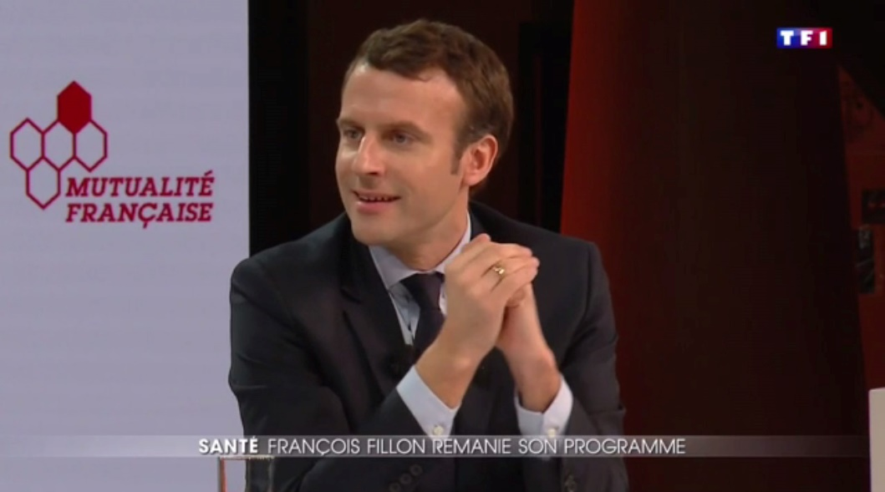
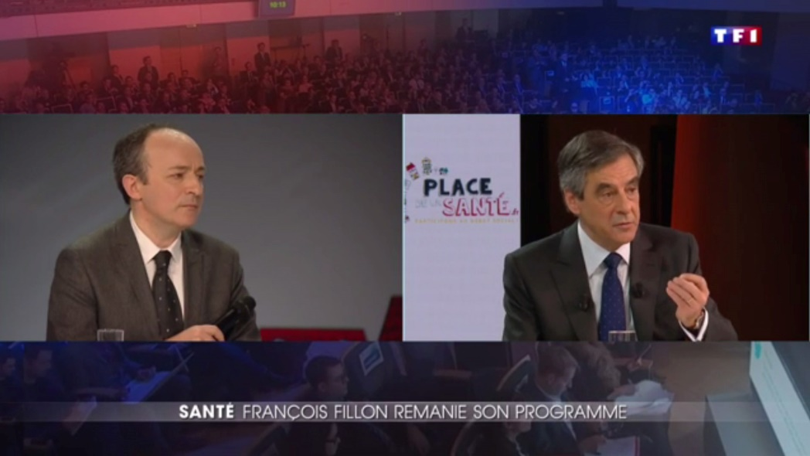
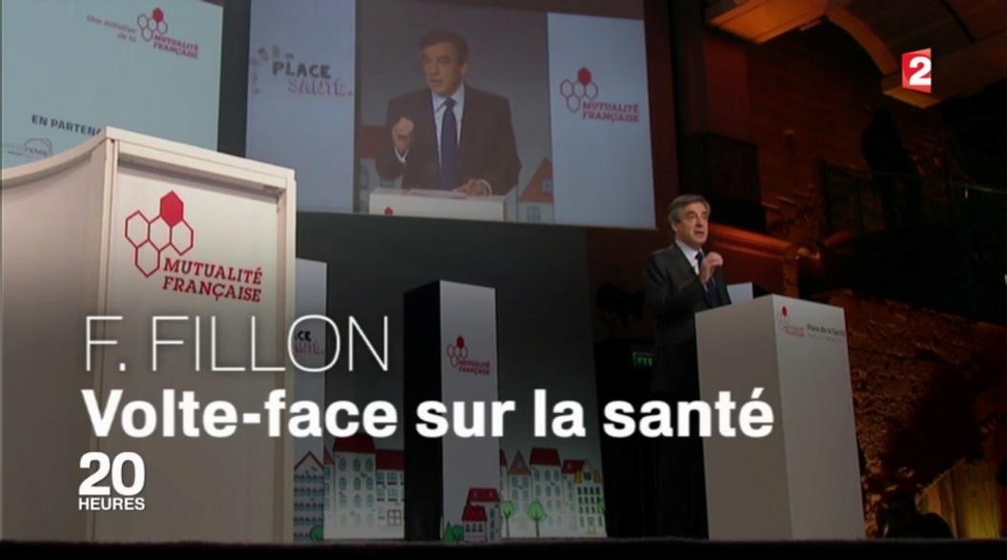
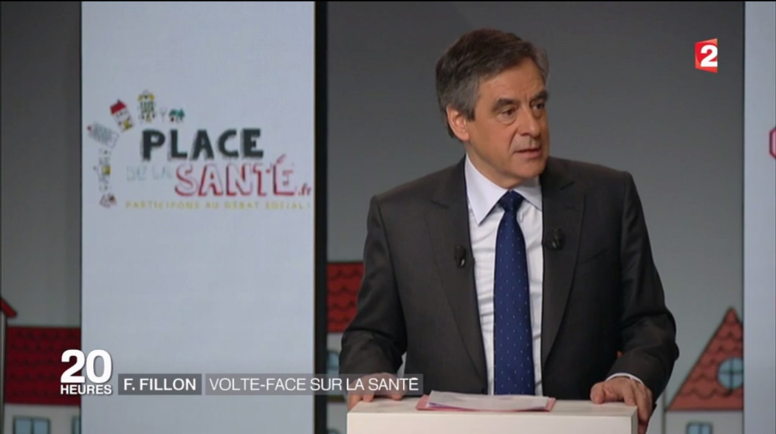
A successful press coverage of the event
The main topic at the evening news on and

Slide 15
Traffic on the Platform
PlacedelaSanté.fr: more than 520,000 visits within 6 months
Time variation with traffic peaks

Slide 16
The lessons that can be drawn from our experience
Key learnings
Mutualité Française is perceived as a major go-between connecting policymakers with citizens’ priorities and hopes as far as health and social protection are concerned
With Place de la Santé, Mutualité Française President, Thierry Beaudet, had the opportunity to establish a direct and personal contact with Emmanuel Macron before his election. This is an asset
Mutualité Française has enhanced mutuals’ expertise and experience and has demonstrated its ability to gather multiple partners around a joint project.

Slide 17
The lessons that can be drawn from our experience
Next steps
In September, the web platform PlacedelaSanté.fr is going to be integrated into the corporate website www.mutualite.fr
Place de la Santé will be a new brand for a kind of online think tank
It becomes the brand name of a series of events open to external stakeholders
The first brand platform of Mutualité Française will be operational by next October
A communication campaign focused on the mutual identity is being prepared: mutuals’ activities and their members’ commitment

