Slide 1
The global reputation report 2016
Liz Green
Senior Vice President, ICMIF
June, 2017
Notes:
My name is Liz Green, I’m SVP at ICMIF and work closely with our CEO Shaun Tarbuck to deliver the global strategy for the cooperative and mutual insurance movement.
Together with our team of 20 staff in the UK - and our regional associations in Europe, the USA and of course Asia and Oceania – ICMIF is driven by one compelling and relentless purpose. It is our vision to protect more lives and livelihoods across the world by growing the cooperative and mutual insurance sector and increasing the number of household protected by 25million by 2020.
Our captivating mission has taken me around the world during the last five years, but this is first time it has brought me to Ireland so as you can imagine I am thrilled to be here in this beautiful country.
Our sector has also made some enormous steps forward in terms of its reputation and so during this presentation I would like to share with you some research and some activities that ICMIF has undertaken with its members to make the progress happen.

Slide 2
In 2012 ICMIF commissioned the world’s first reputation study for our sector…
A one year global digital reputation study (Nov 2011-2012)
Behaviour and sentiment
16 languages tracked
Notes:
It was at ICMIF’s 2013 biennial conference in Cape Town, South Africa that I first presented a new – never before attempted global study - a research project that was designed to measure one of the industry’s most important and volatile assets – reputation.
By understanding the reality of our sector’s reputation, ICMIF was able to inform its strategy, identify stakeholders and apply interventions to help strengthen the perception of the sector.
So lets take a quick look at the hallmarks of the original study:
A one year global digital reputation study of the insurance sector – Nov 2011 to Nov 2012.
• Digital search – largest potential sample available, all stakeholders.
• Look at behaviour and sentiment, retrospectively during a 12 month period.
Its fully inclusive - every ICMIF member communicates in one of the 16 languages being tracked

Slide 3
ICMIF’s 2015-2018 strategy focuses on increasing the sector’s visibility
Raising the visibility of the sector
Establishing a louder voice in global conversations
Strengthening the sector’s association with strong financial performance
Increasing references made by external audiences about cooperative and mutual values
Increasing positive sentiment towards the sector
Building a greater profile with national government/policymakers
Identify, promote and mobilise sector leaders to lead global conversations
Notes:
Working with ICMIF’s Board and Executive Team our 2015-2018 strategy was developed to build upon our successful areas of reputation strengths as well as addressing where there were weaknesses. This slide outlines the key themes from our strategy that were influenced by the reputation research.
In the following slides I cover how ICMIF addressed the challenges which were highlighted during the 2012 study and what how the findings varied between the two research periods.

Slide 4
The global reputation report 2016
Measures the progress ICMIF has made since implementing the 2015-2018 strategy
Reflects on why reputation categories might have moved
Notes:
In 2016 we launched the latest global reputation report at ICMIF’s Board Meeting in Kenya. The report analysed the progress made since 2012 and reflects on what might have influenced the changes

Slide 5
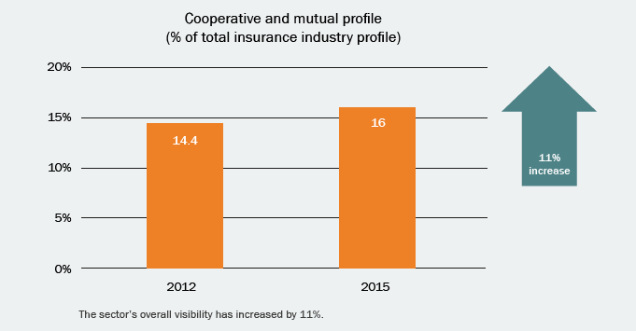
Priority one: Increasing the overall visibility of the global cooperative and mutual insurance sector
Notes:
Good reputation is a basic reputation quality. The sector must be seen by a broad range of stakeholders to be recognised and understood.
Since 2012 visibility of the sector has risen to 16% of the total insurance market’s profile. This is an 11% improvement since 2012, however as the mutual market’s share of the total market is 27% it is fair to say that there is still room for improvement.

Slide 6
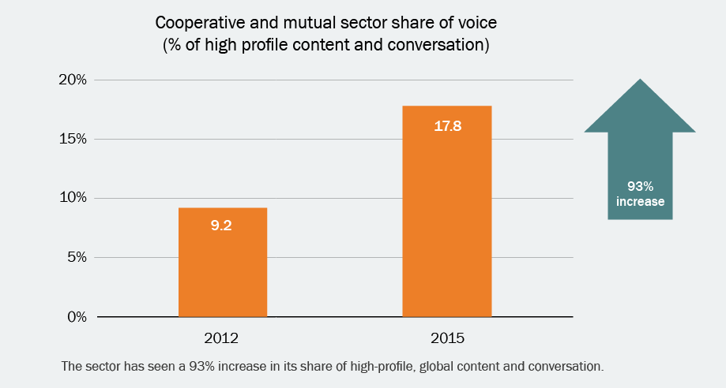
Priority two: Increasing the sector’s share of insurance conversation
Notes:
Being visible is vital, but being interesting and engaging is a whole other challenge. Being seen in the right places and participating in the right conversations about relevant issues is of paramount importance.
In 2012 the sector held just 9.2% share of insurance conversations. By 2016 this has increased by 93% to 17.8%

Slide 7
ICMIF’s activity 2012-15
Engagement with global forums
United Nations
World Bank
B20 Working Groups
Insurance Development Forum
Communications channels
Increased volume of press releases
Increased volume of features
Increased Twitter and LinkedIn activity
Notes:
So what activities may have influenced these two increases in reputation?
Firstly ICMIF has increased its volume of communications to its members, via social media and through global media titles
Secondly we have engaged with some of the world’s leading opinion formers in the UN, World Bank, B20 and other forums to position our model’s role in socio-economics.
Themes included combatting the effects of climate change, increasing resilience and reducing disaster risk.
This work has effectively increased ICMIF and its members reputation as a key actor on the global insurance stage.

Slide 8
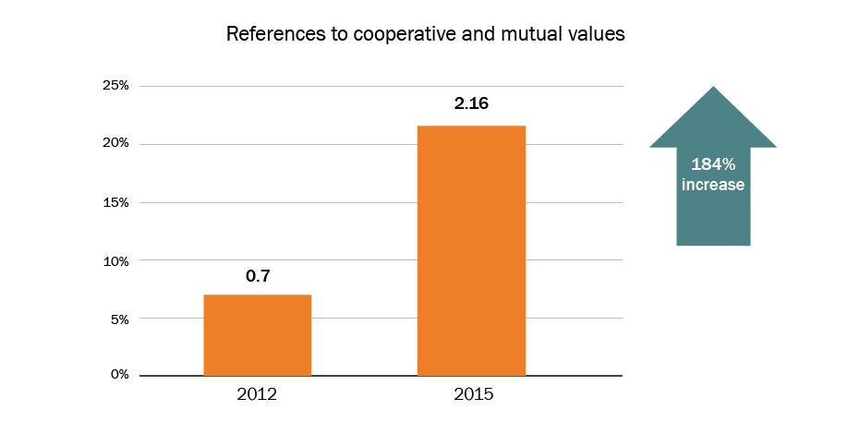
Priority three: Being recognized and understood for our cooperative and mutual difference
Notes:
Holding a distinct and unique position in stakeholders minds strengthens reputation. An organization or association must therefore be clear about what values it wishes to promote and how those values transform into tangible customer outcomes.
In 2012 only 0.7% of the sector’s conversation referred to values-based difference. By 2015 the sector was being associated with its values far more frequently resulting in a 184% increase in references

Slide 9
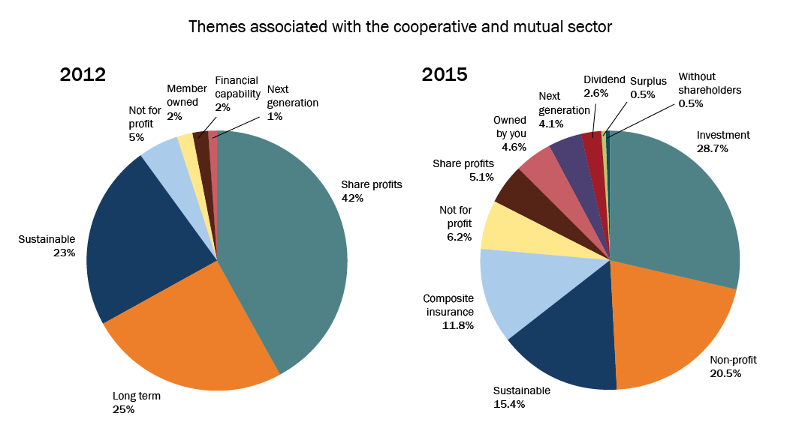
Priority three: Being recognized and understood for our cooperative and mutual difference
Notes:
The context in which the increase was achieved are dominated by references to ‘investment’, ‘not-for-profit’ and ‘sustainability’. This compares with the 2012 references which were also focused on ‘sustainability’ but also on ‘share of profits’ and ‘long term’

Slide 10
ICMIF’s activity 2012-15
Increased associations with ‘investment’ & ‘sustainability’ suggests ICMIF’s involvement with the following is having a positive impact on the sector’s reputation:
Development and launch of UNEP-FI Principles for Sustainable Insurance
Shaun Tarbuck speaking on behalf of the sector at the UN Summit 2014 regarding Climate Smart Investments
The appointment of Shaun Tarbuck to the Board of the Green Bonds Standard
Notes:
While this improvements noted are pleasing, ICMIF’s work with the high profile opinion formers in the United Nations and Green Bonds Standard are likely to be having an impact on what the sector is becoming known for.
Mutual and cooperative insures would benefit from defining and clearly communicating their points of difference to help their national stakeholders recognised and understand their brands more easily.

Slide 11
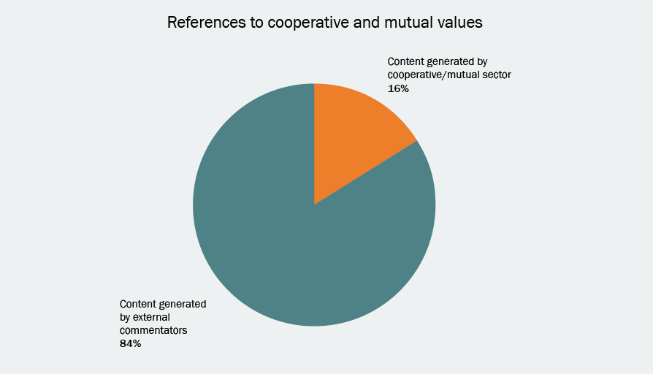
Priority four: External commentators are reflecting our values
Notes:
This is a particularly pleasing finding from this year’s research. It appears that the work that ICMIF and its members have been doing to increase awareness and understanding of the sector is having an impact. We can see in this in the fact that external influencers are now describing our values more widely and more effectively.
More than four out of every five references to cooperative and mutual values are coming from external commentators. This is a very strong position to be in but heightens the need to carefully shape understanding and what we want people to believe about us.

Slide 12
ICMIF’s activity 2012-15
Increased understanding of the sector’s values is likely to have been driven by the publishing and promotion of the following publications:
Values-based online marketing (2014)
Mutual and cooperative values sell (2014)
Protecting Lives and Livelihoods - the ICMIF Manifesto (2015)
A practical guide to understanding mutual insurance – a guide for supervisors and regulators (2015)
Notes:
The increased understanding of our sector’s values is likely to have been influenced by a number of publications issued by ICMIF which have focused on encouraging various stakeholder groups to acknowledge our differences as a sector.
Values-based online marketing and mutual values sell both investigated how members are using their values as a point of difference.
Our manifesto outlines how our intent as a sector firmly prioritises people and planet before profit
Our supervisors and regulators guide to mutual insurance is a document used by members to help educate their regulators and supervisors about our unique attributes as a sector.

Slide 13
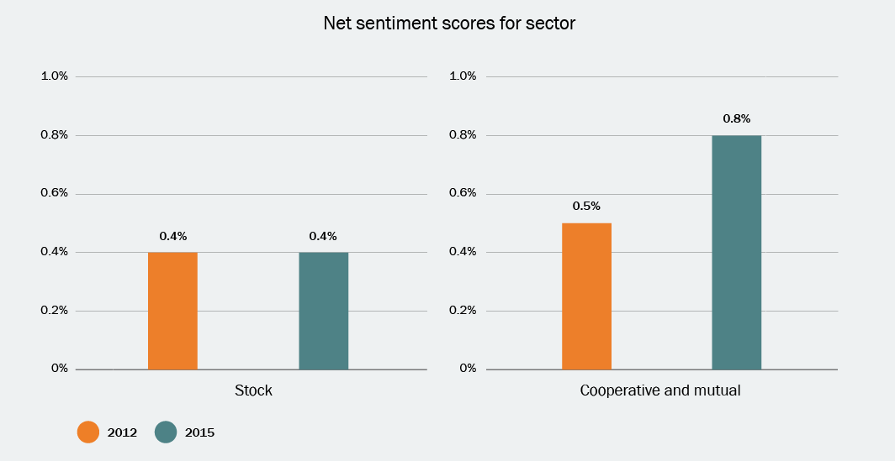
Priority five: Creating positive sentiment towards our sector
Notes:
Achieving highly visible content that communicates our difference only helps our reputation if the sentiment is positive.
The Net Sentiment towards the sector was already positive in 2012 but by 2015 had improved by 60%, a sign that good will towards the sector is growing rapidly.

Slide 14
ICMIF’s activity 2012-15
Increased Net Sentiment Score for the sector can be attributed, in part to the increased volume of stories being shared relating to initiatives including:
ICMIF’s 5-5-5 Microinsurance Strategy
Swiss Re’s sigma report: A comeback for mutual insurance?
The Cambridge Institute for Sustainability Leadership: Rethinking insurance for sustainable development
Notes:
So what part has ICMIF played in driving this shift in sentiment? It is likely that the increased volume of stories being shared about ICMIF’s 5-5-5 Microinsurance Strategy which aims to develop mutual insurance in five emerging markets over a five year period, reaching 25m new households by 2020
ICMIF also collaborated with the widely acclaimed Swiss Re sigma report ‘A comeback for mutual insurance’. In the report it points out that while the stock sector insurers are struggling mutual and cooperatives are gaining important ground. Interestingly the report also points to the importance of digital technology when serving members long term interests, a subject I know will be discussed on today’s agenda.
ICMIF also worked with the Cambridge Institute for Sustainability Leadership to produce a report Rethinking insurance for sustainable development. In the report it called for access to insurance within emerging markets to be accounted for by regulatory environments in order to aid sustainable development. It used case studies from ICMIF’s member CARD MBA in the Philippines it demonstrated to validity of the mutual model when providing adequate insurance protection in high risk economies.

Slide 15
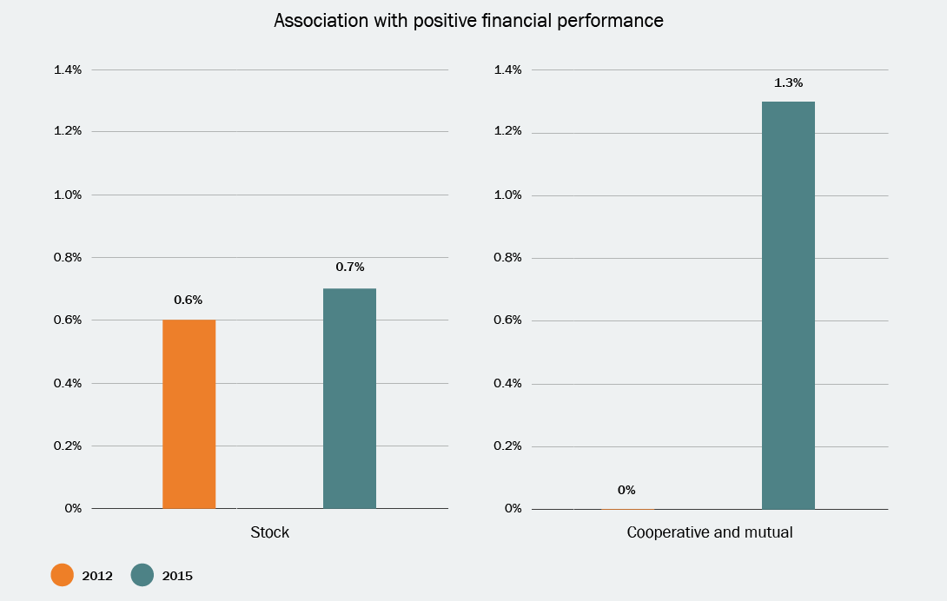
Priority six: Communicating the sector’s financial strength
Notes:
To perceived strong financial performance is core to reputational strength. In 2012 the sector’s association with financial strength was one of its weaker features and it is therefore again heartening to see a turnaround in the 2016 findings

Slide 16
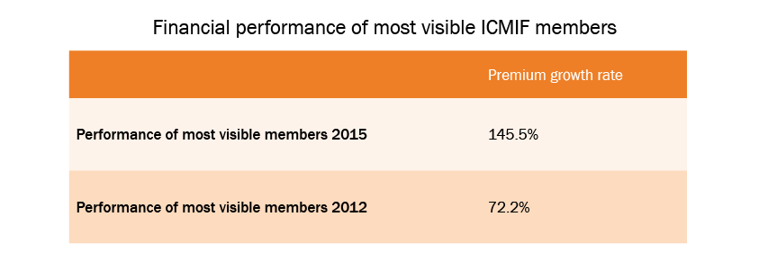
Priority seven: The most visible cooperative and mutual insurers are those that are performing most positively in financial terms
Notes:
The perceived success of the sector is also being positively influenced buy the higher profile, fastest growing insurers. The most visible ICMIF members globally had an average premium growth rate of 145.5% in the latest report, almost doubling 2012’s performance.

Slide 17
ICMIF’s activity 2012-15
The sector’s financial performance has been researched and analysed by ICMIF’s Mutual Market Share Report which is attracting increasing media attention:
A correlation noted between the fastest growing cooperative/mutual insurers and those with the highest visibility
Regularly communicating success metrics – or points of difference - might offer members opportunities for increased visibility.
ICMIF’s Communications Leaders Forum will consider this point.
Notes:
Between 2012-2015 ICMIF has achieved increasing volumes of media coverage and opinion former comment about its Global Mutual Market Share report, which is now in its 7th year. The fastest growing organisation are in fact those who have the highest visibility and the qualitative case study report – mutual values sell – explores how they do this in some detail.
It is noted in this study that regular reporting of financial success metrics helps strengthen insurers reputations. However financial success metrics clearly vary from organization to organization, depending on their strategy. This is therefore a topic which will be explored by ICMIF’s CLF

Slide 18
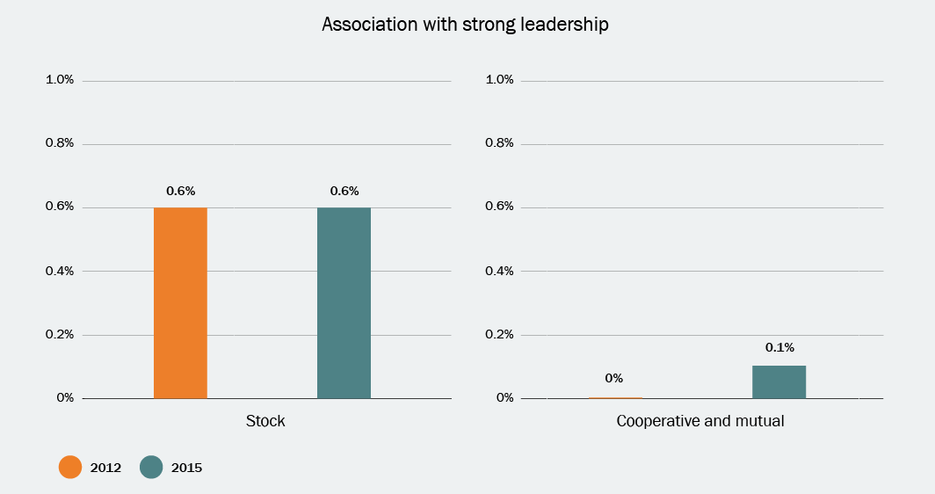
Priority eight: Being associated with strong leadership and leaders
Notes:
The ability to lead and be seen to have strong leaders are two further indications of reputation strength. Between 2012-2015 shareholder organizations have continued to demonstrate reputations for strong leadership, while in our sector is only just beginning in emerge in terms of being associated with strong leadership.
Strong leadership on a sector level means identifying key issues where we can all make a tangible impact and then mobile charismatic, passionate leaders to tell the story.

Slide 19
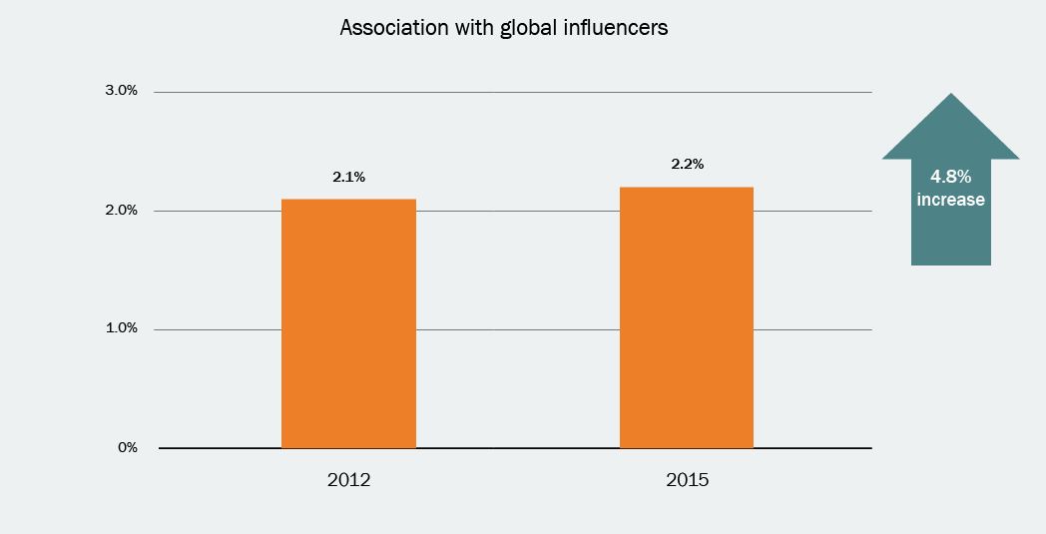
Priority nine: Growing the sector’s profile among key reputation influencers, globally
Notes:
Identifying external stakeholders who influence the sector was a key goal following our 2012 study. Intense work has taken place influencing stakeholders at a global level for the past three years. This is a long game but is already having an impact, resulting in a 4.8% increase in our association with global influencers in three years.

Slide 20
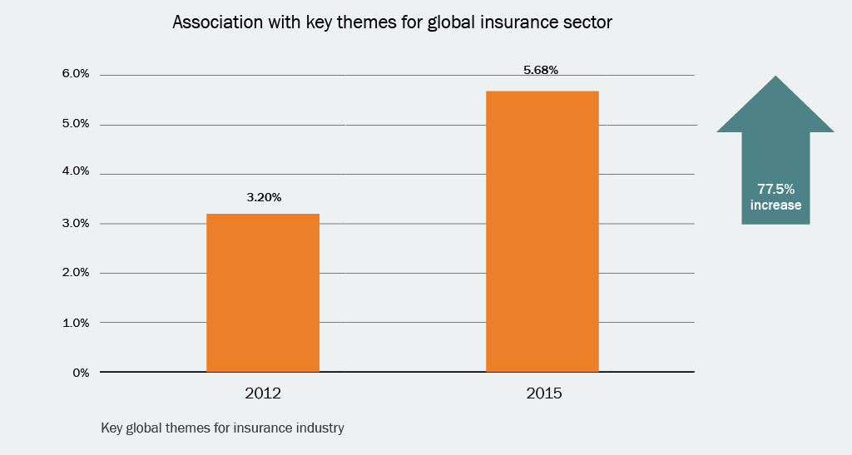
Priority ten: Being well represented in conversations about key global topics for insurance
Notes:
Now that the influencers are identified the task is to be part of the insurance-related conversations. Since 2012 ICMIF has worked hard to affect a dramatic change with the sector now increasing its association with global issues by 77.5%.

Slide 21
ICMIF’s activity 2012-15
The sector’s association with strong leadership is tightly linked with an increase in the profile of its key influencers.
ICMIF’s Leadership team and members of its Board are now involved in global level decision making and discussions including:
The B20 (make policy recommendations on behalf of the business world to the G20)
The United Nations International Strategy for Disaster Reduction (UNISDR)
United Nations Development Program (UNDP)
Notes:
Strong leadership, a growing profile and being involved in the right conversations have been achieved by a number of ICMIF members and the ICMIF leadership team working together to participate in some of the most important working groups in the world, including those run by the B20 and the United Nations.
By being visible at these meetings, with tangible examples of action being taken by our sector, our story has been difficult to ignore. Our spirit of cooperation and action is seen by many global opinion formers as our point of difference.

Slide 22
Concluding comments
The improvement in our sector’s reputation over three years has been considerable. Much is attributed to the new ICMIF strategy, but there are still many more opportunities ahead:
Develop a more confident voice
Showcase more performance-related success stories
Broaden leaders’ visibility
Continue to build the sustainability messages
Become more emotive – tell more stories to wider audiances
Increase coordinated, collective communication
Notes:
We are proud of the achievements that we have made in three years. Our new strategy is clearly having an impact and is inspiring our members to take action. We must however continue to build on our achievements and develop an even more confident voice.
Talking more about performance success stories isn’t natural for many cooperative and mutuals but would help to strengthen their reputations. Regular dialogues between global media and leadership figures from all regions would boost the profile of the sector’s leaders and allow them to talk more about the sustainability messages and number of lives that our insurance model affects. Consistency in messaging and timing will achieve the greatest impact
Mobilising leaders also allows for more story telling. A great example of this behaviour is Dr Aris Alip from Card MBA in the Philippines who has spoken widely and passionately to the media and global events including World Bank. He is able to tell the story of how his organization’s point of difference makes a difference to the lives and livelihoods of people in his country. He has been so successful in his communication that CARD are regularly used as a case example of excellence.
We hope that this presentation has inspired you to get involved with ICMIF to further improve the sector’s reputation and we hope that you will join us in London later this year when we will host of Biennial Conference which will feature a special Young Leaders event.

Slide 23
Thank you!

